Slide 1

LEADERSHIP _______________
SUBMITTED TO :
DR. ARCHANA SINGH
SUBMITTED BY:
AMAN VERMA (2007340139001)
DEPARTMENT OF INFORMATION TECHNOLOGY
RAJKIYA ENGINEERING COLLEGE, BANDA

Slide 2
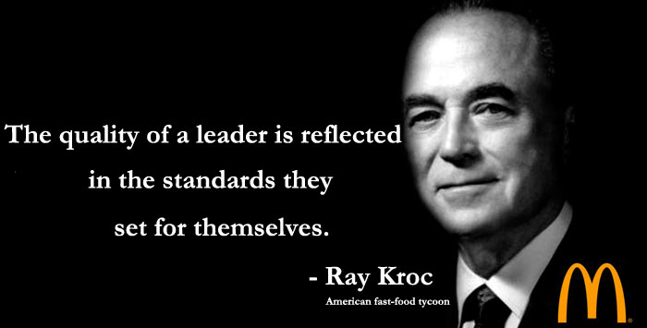
LEADERSHIP
Leadership is the ability to move or influence others towards achieving individual or group goals.

Slide 3
Importance of Leadership
Initiates action
Motivation
Providing guidance
Creating confidence
Building morale
Builds work environment
Co-ordination-

Slide 4

Leadership Skills
Communication
Motivation
Delegating
Positivity
Trustworthiness
Creativity
Feedback
Responsibility
Commitment
Flexibility

Slide 5
Role of a Leader
Required at all levels
Representative of the organization
Integrates and reconciles the personal goals with organizational goals
He solicits support
As a friend, philosopher and guide

Slide 6
Qualities of a Leader
Physical appearance
Vision and foresight
Intelligence
Communicative skills
Objective
Humanist
Empathy
Sense of responsibility
Self-confidence and will-power
Knowledge of work

Slide 7
Emotional Intelligence for Leaders
Self Awareness
Self Management
Social Awareness
Relationship Management or Social Skills

Slide 8
Leadership Ethics
Dignity and respectfulness
Serving others
Justice
Community Building
Honesty

Slide 9
Effective Leadership Skills
Master Your Time
Ask Questions
Provide Work-Life Balance
Manage Employee’s Professional growth
Let your employees speak
Facilitate Brainstorming... Generate ideas
Be Visionary

Slide 10
Leadership Styles
Autocratic leadership style
The Laissez Faire Leadership Style
Democrative/Participative leadership style
Bureaucratic leadership

Slide 11
Leadership Styles
Autocratic leadership style: Complete command over their team/employee
The Laissez Faire Leadership Style: leader totally trusts their employees/team to perform the job themselves.
Democrative/Participative leadership style: The leaders invite and encourage the team members to play an important role in decision-making process, though the ultimate decision-making power rests with the leader.
Bureaucratic leadership: Here the leaders strictly adhere to the organizational rules and policies. Also, they make sure that the employees/team also strictly follows the rules and procedures.

Slide 12
How to be a Good Leader
Motivation
Commitment
Self-sacrifice
Honesty
Determination
Resourcefulness
Daring
Knowledge
Good communication skills
Passion
Responsibility
Judgement

Slide 13
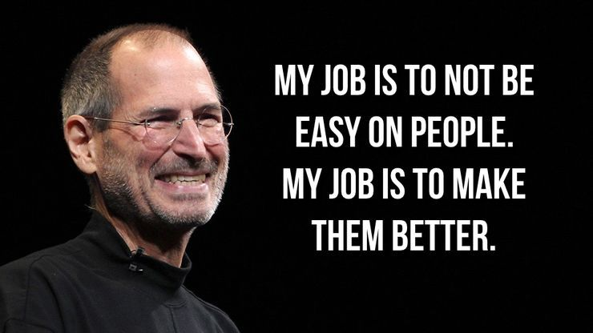

THANK YOU All
If you have any question
Please ask?
References : Wikipedia , Forbes.com, managementstudyguide.com

